Slide 1

Online Quiz System
Using Maps and Lists to Manage Questions and Scores

Slide 2
Modules
User Management
Quiz Management
Question Bank
Scoring System
Result Analysis
Admin Panel

Slide 3
UML Diagrams Overview
Class Diagram
Use Case Diagram
Interaction Diagram
State Chart Diagram
Activity Diagram

Slide 4
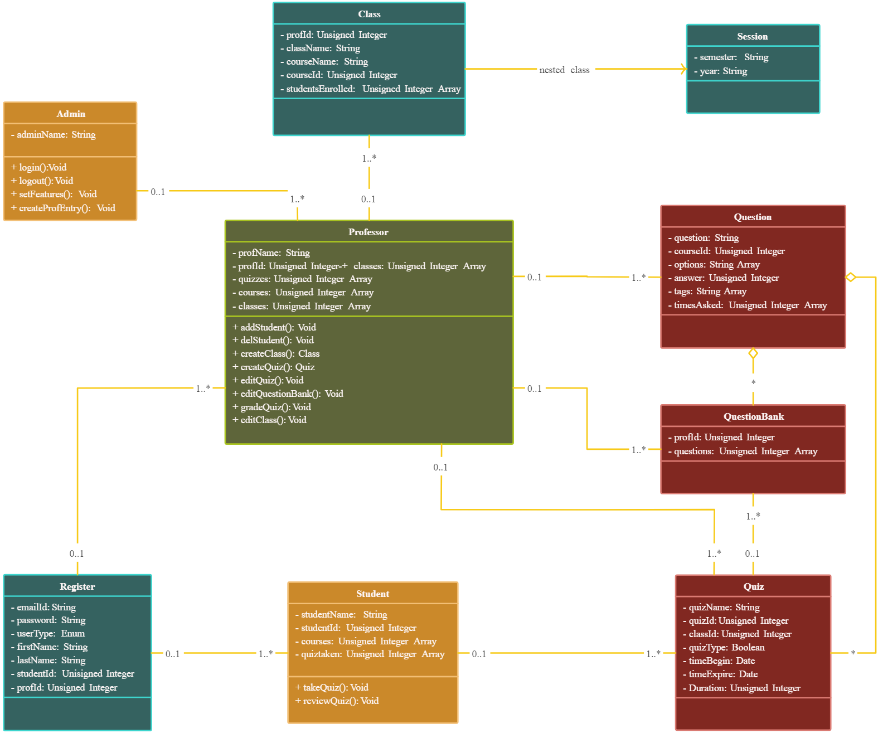
Class Diagram

Slide 5
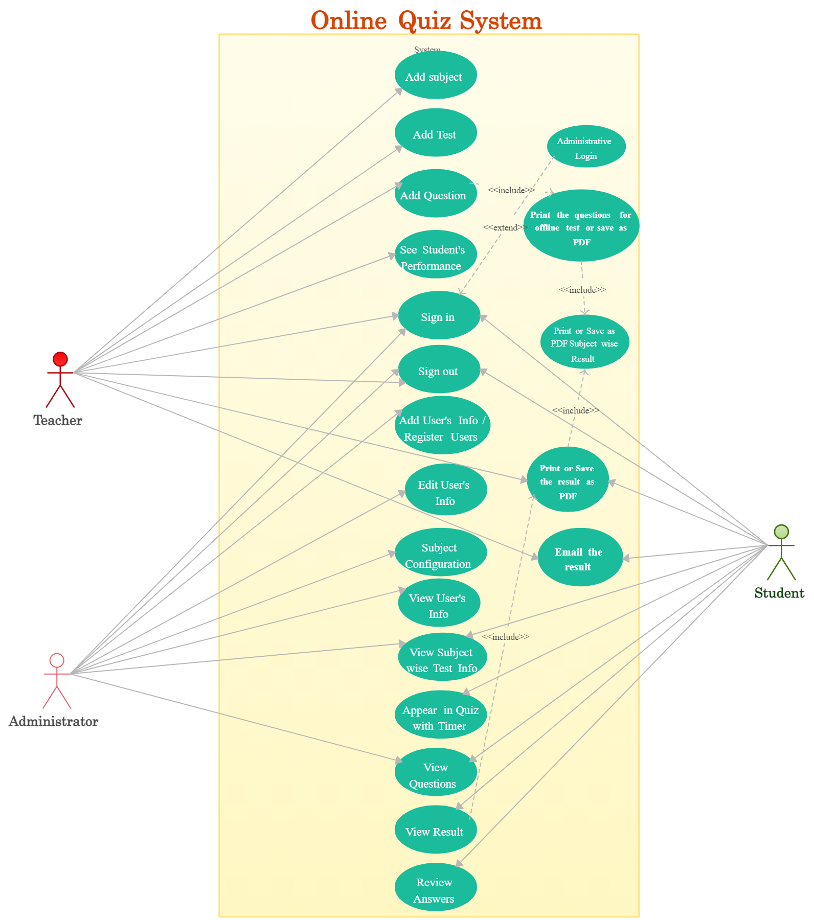
Use Case Diagram

Slide 6
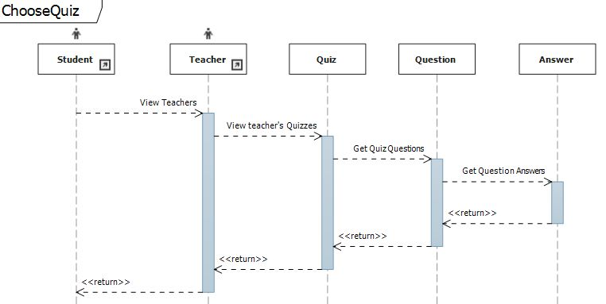
Interaction Diagram

Slide 7
State Chart Diagram
Quiz States
[Quiz created]
[Quiz created]
Not yet open
Open
Closed
Attempt states
[2minutes after submit all and finish]
[attempt started]
[Submit all and finish]
Attempt in Progress
Immediately after the attempt
Attempt finished

Slide 8
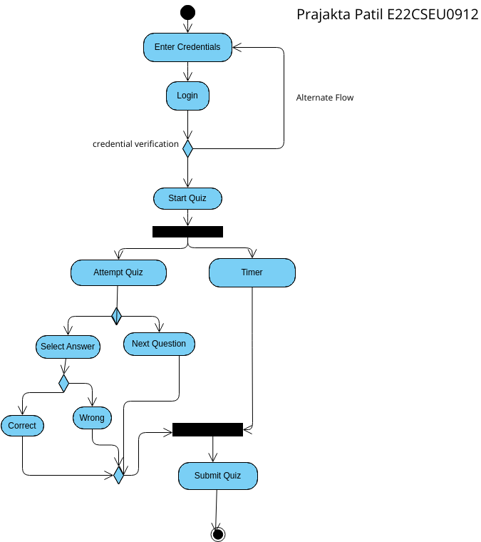
Activity Diagram

